Slide 1
Comparing Fractions and Percentages of Quantities
Year 11 Essentials

Slide 2

Learning Intentions
Students will be able to:
Find the percentage of a quantity
Express one quantity as a percentage of another
Solve problems relating to percentage increase/decrease and profit/loss
Apply this knowledge to real-life scenarios
WICOR

Slide 3
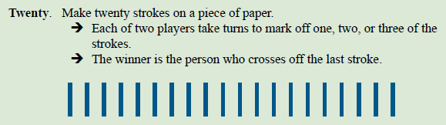
But first, a game
Notice any patterns?

Slide 4
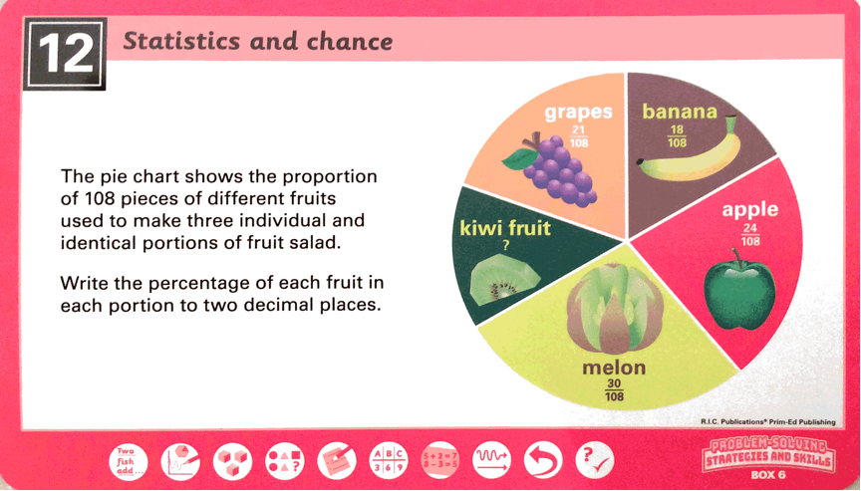
From last class...

Slide 5
Think-Pair-Share
With a partner, come up with:
3) Ways we use percentages in our daily lives
2) Jobs that regularly deal with percenatges
1) Way they make our lives easier
Share with the class
WICOR

Slide 6

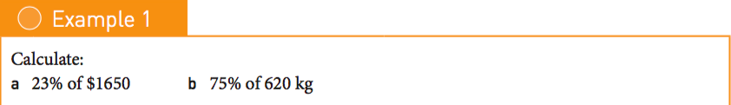
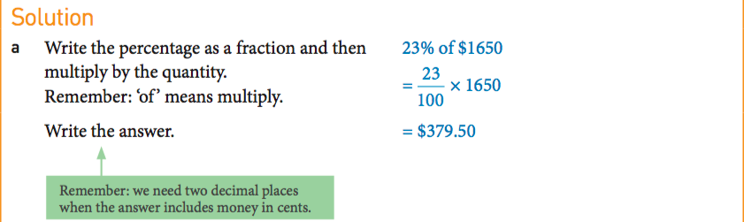
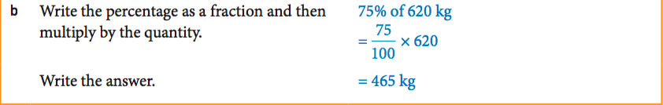
24
7
30
Understanding Percentages Further
Date
EQ – How can we apply our knowledge of percentages to different contexts?
First off: how do we find a percentage of a quantity?

Slide 7
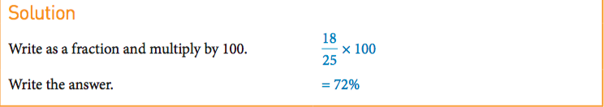
24
7
30
Understanding Percentages Further
Date
EQ – How can we apply our knowledge of percentages to different contexts?
How do express one quantity as a percentage of another?

Slide 8

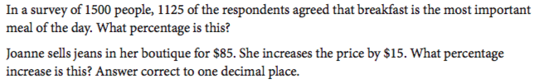
1)
2)
3)
4)

Slide 9
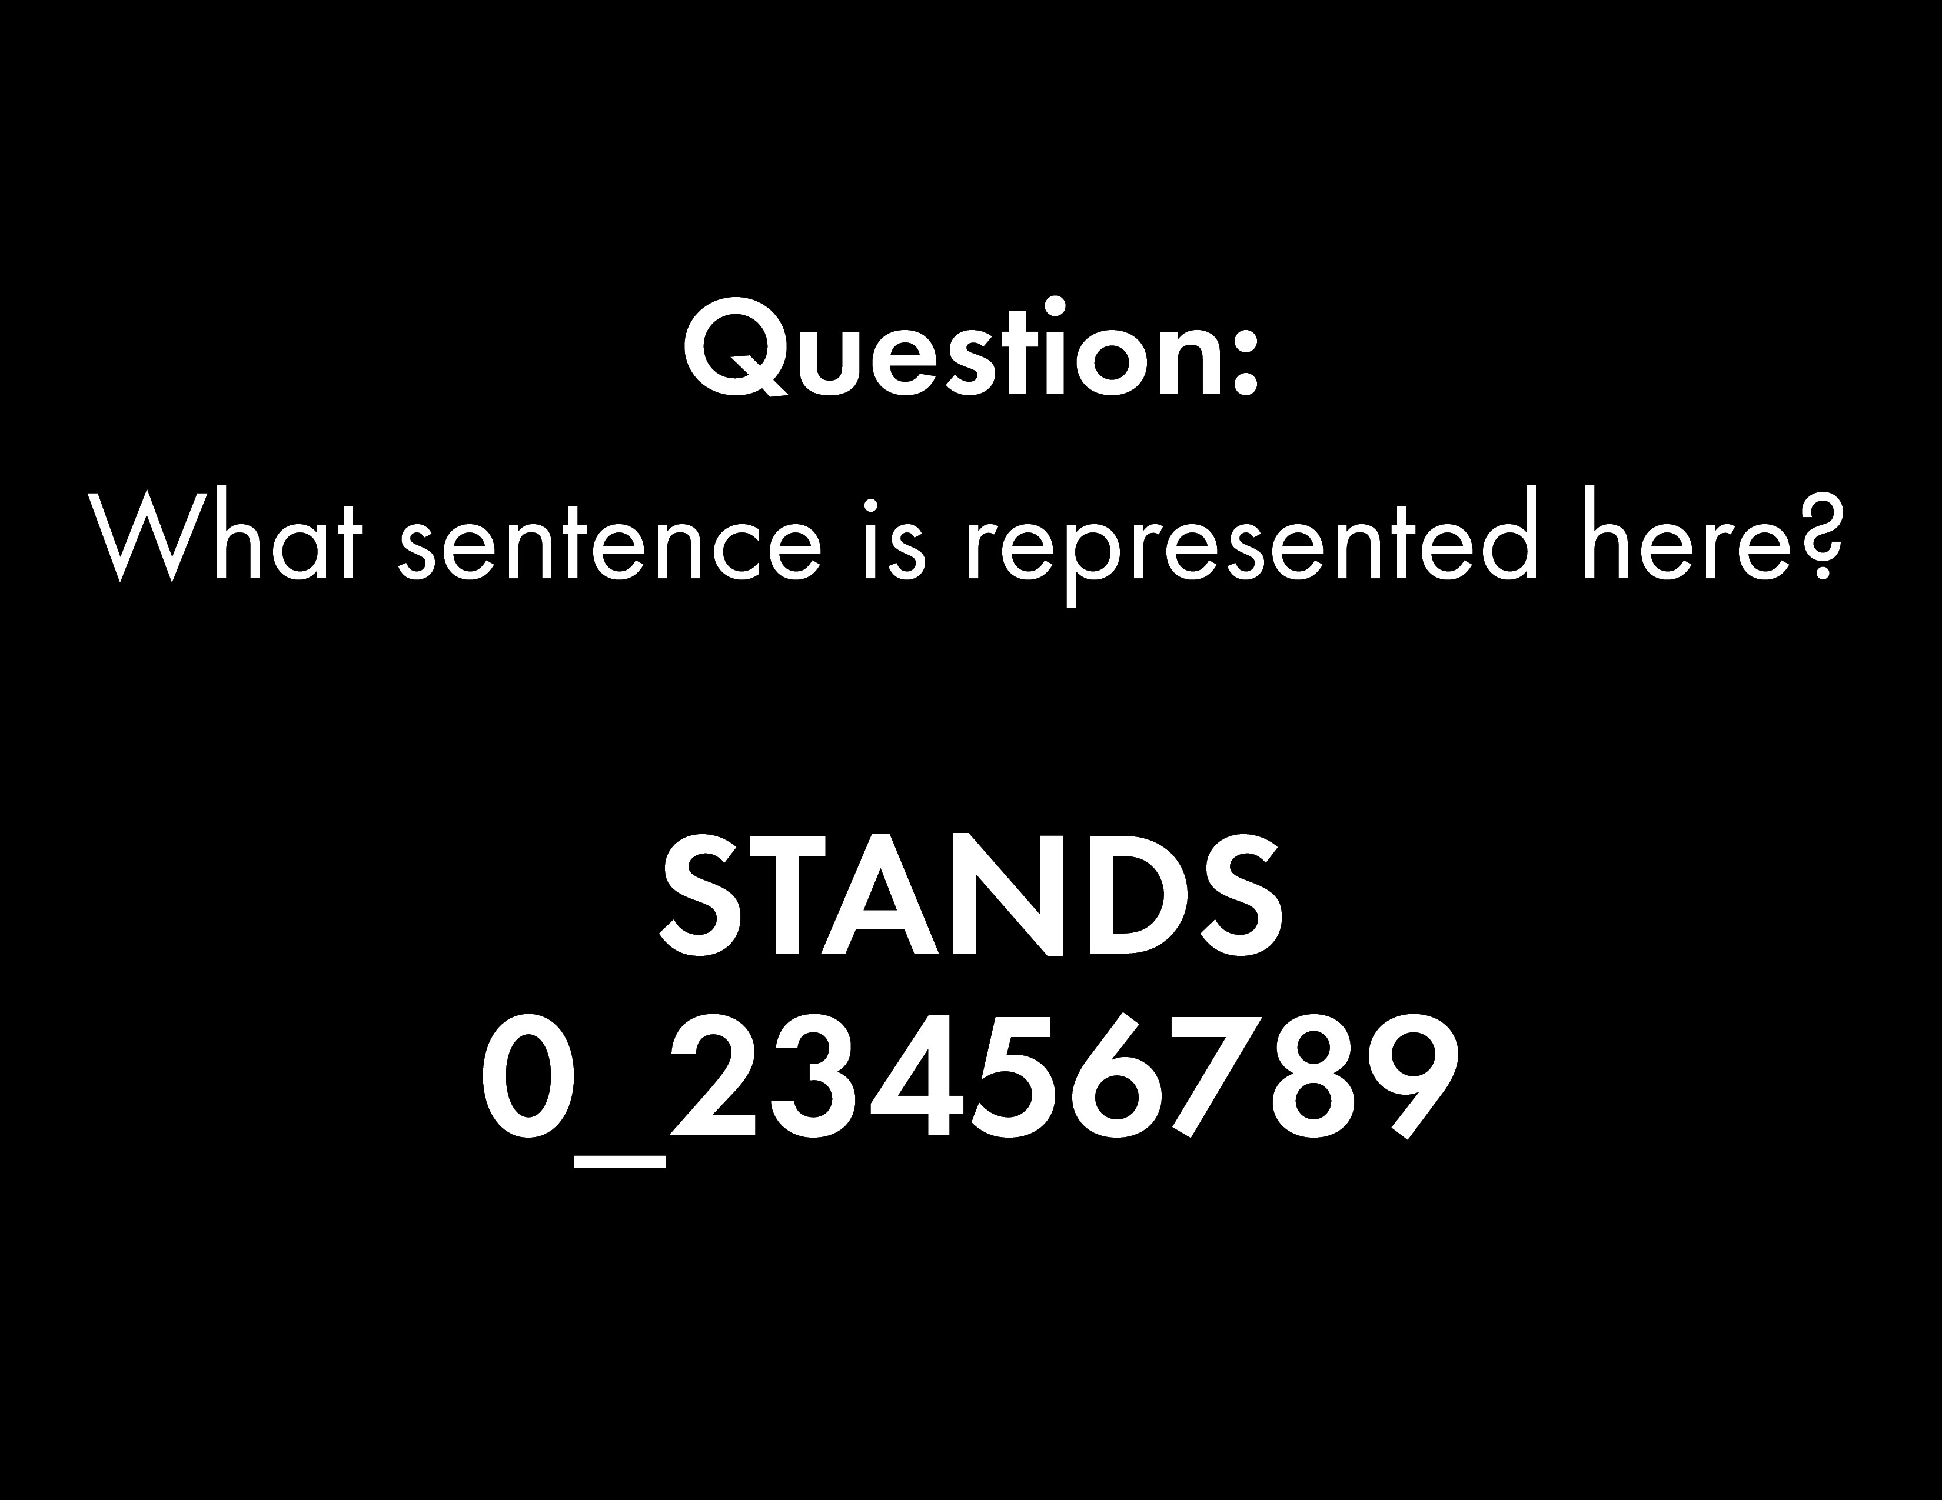

Slide 10


Slide 11

Does no one?
Show of thumbs

Slide 12



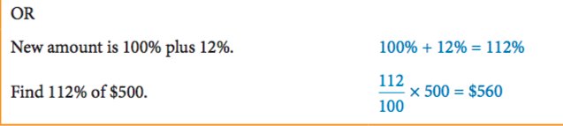
24
7
30
Understanding Percentages Further
Date
EQ – How can we apply our knowledge of percentages to different contexts?
How do we calculate the percentage increase/decrease of something?

Slide 13

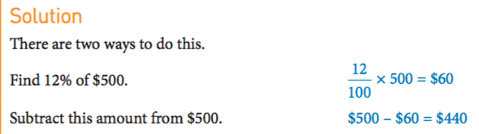
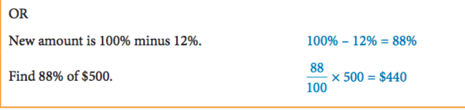
24
7
30
Understanding Percentages Further
Date
EQ – How can we apply our knowledge of percentages to different contexts?
Similarily:

Slide 14
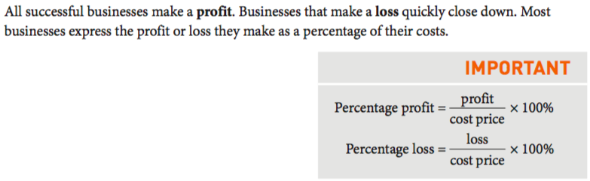
24
7
30
Understanding Percentages Further
Date
EQ – How can we apply our knowledge of percentages to different contexts?
How can this be applied to the world of business?
Profit = Selling Price – Cost Price
Loss = Cost Price – Selling Price

Slide 15
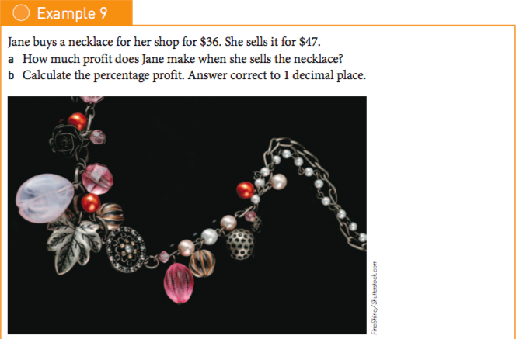
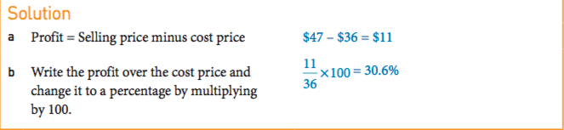
24
7
30
Understanding Percentages Further
Date
EQ – How can we apply our knowledge of percentages to different contexts?

Slide 16
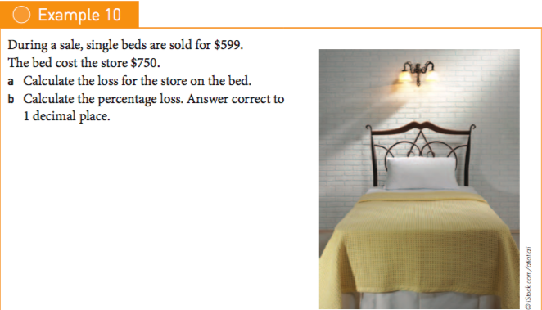
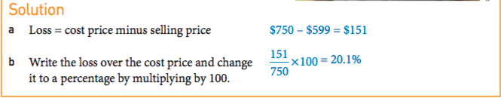
24
7
30
Understanding Percentages Further
Date
EQ – How can we apply our knowledge of percentages to different contexts?

Slide 17

Do you understand? Fists of Five
Notes:
Check for Understanding

Slide 18
Nelson Worksheet – Percentage Problems

